Slide 1
MACHINE LEARNING
UNIT-1
Ingredients
of
Machine Learning

Slide 2
Topics
Definition of Machine Learning
Ingredients of Machine Learning

Slide 3
Machine Learning Definition
The field of study that gives computers, the ability to learn without being explicitly programmed.
Machine learning is the systematic study of algorithms and systems that improve their knowledge or performance with experience.

Slide 4
Machine Learning Definition
A computer program is said to learn from experience E with respect to some class of tasks T and performance measure P, if its performance at tasks in T, as measured by P, improves with experience E.

Slide 5
Machine Learning Definition
A computer program is said to learn from experience E with respect to some class of tasks T and performance measure P, if its performance at tasks in T, as measured by P, improves with experience E.
Classify e-mails as spam or not spam
What type of e-mails are spam or not spam
Number of e-mails correctly classified as spam or not spam

Slide 6
Ingredients of Machine Learning
The three ingredients of Machine Learning are:
Task
Model
Features
Machine Learning is concerned with using the right features to build the right models that achieve the right tasks.
Models lend the machine learning field diversity, but tasks and features give it unity.

Slide 7
Ingredient-1: Tasks

Slide 8
Tasks
Tasks are the problems that can be solved with machine learning
The most common tasks in ML are
Supervised Learning Tasks
Classification and
Regression
Unsupervised Learning Tasks
Clustering
Association Rules
Regression and Classification algorithms are Supervised Learning algorithms. But the difference between both is how they are used for different machine learning problems.

Slide 9

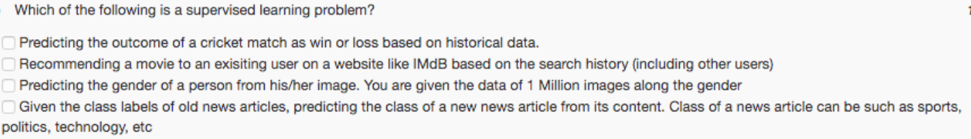
Quiz
Q1: Given e-mails labeled as spam/not spam, learn a spam filter to decide whether a mail is spam or not spam.
Q2: Given a set of news articles on web, group them in to set of articles about same story.
Q3: Given customer data automatically discover market segments and group customers in to different market segments.
Q4: Given database of patients having diabetics or not. Predict whether a new patient having diabetics or not.
X

Slide 10
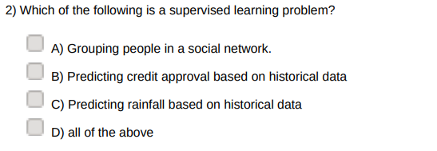
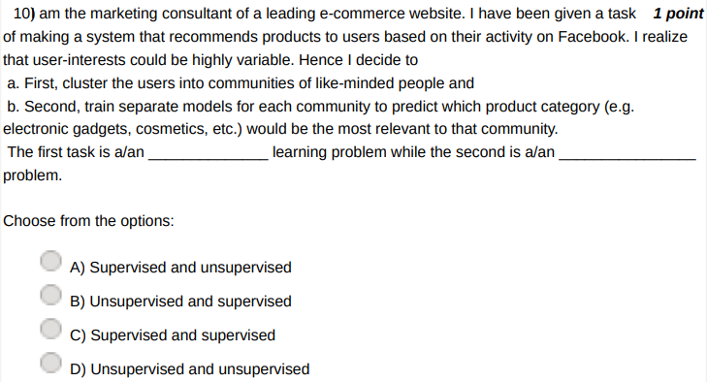
Quiz

Slide 11
Tasks-classification
Classification is a process of finding a function which helps in dividing the dataset into classes based on different parameters, i.e., The task of the classification is to find the mapping function to map the input(x) to the discrete output(y).
In Classification, a computer program is trained on the training dataset and based on that training, it categorizes the data into different classes.
Example: The best example to understand the Classification problem is Email Spam Detection.
The most common types of classification are
Binary classification
Non-binary in terms of two binary classifications
Multi-class Classification

Slide 12
Tasks-Regression
Regression is a process of finding the correlations between dependent and independent variables.
The task of the Regression algorithm is to find the mapping function to map the input variable(x) to the continuous output variable(y).
It helps in predicting the continuous variables such as prediction of Market Trends, prediction of tomorrow temparature etc.
Example: Suppose we want to do weather forecasting. In weather prediction, the model is trained on the past data, and once the training is completed, it can easily predict the weather for future days.

Slide 13
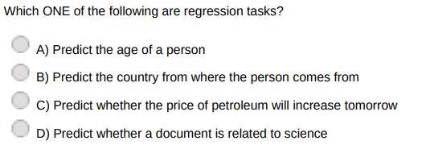
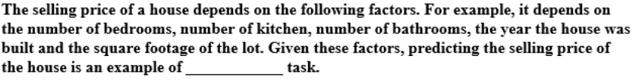
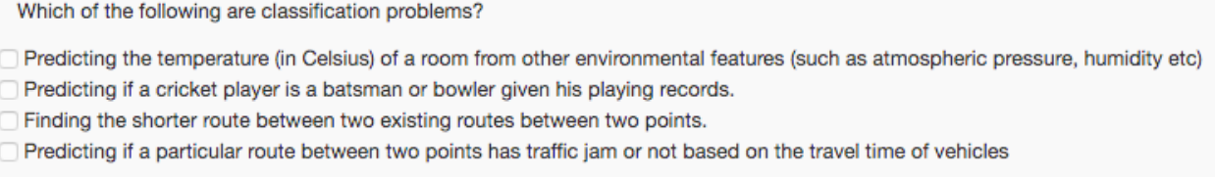
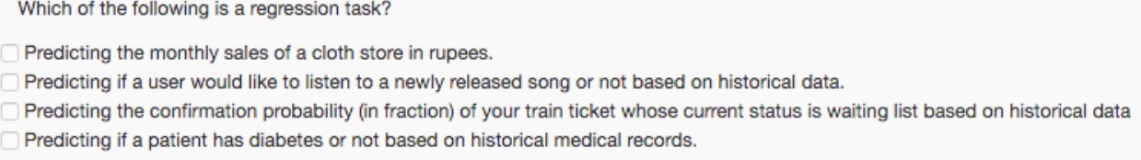
Quiz

Slide 14
Tasks-Clustering
Can we learn to separate the data without a labelled training set?
The task of grouping data without prior information (labels) of data is called clustering.
clustering algorithm works by assessing the similarity between instances (the things we’re trying to cluster) and putting similar instances in the same cluster and ‘dissimilar’ instances in different clusters.

Slide 15
Tasks-Evaluating the Performance
Test Data
Cross-validation
Performance measures

Slide 16
Ingredient-2: Models

Slide 17
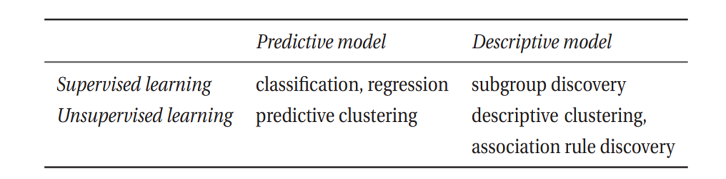
Models
Models are the output of machine learning. Models form the central concept in machine learning as they are what is being learned from the data, in order to solve a given task.
Categorization of Models: Predictive Vs Descriptive
whether the model output involves the target variable or not?
Predictive model if it does, and a descriptive model if it does not.

Slide 18
Models
Another Categorization of Models: based on the process used
Three groups of models:
Geometric models
probabilistic models and
logical models

Slide 19
Geometric Model
The instance space is the set of all possible or describable instances, whether they are present in our data set or not.
A geometric model is constructed directly in instance space, using geometric concepts such as lines, planes and distances.
Geometric Models are Easy to Visualize.
Geometric concepts that potentially apply to high-dimensional spaces are usually prefixed with ‘hyper-’: for instance,
A decision boundary in an unspecified number of dimensions is called a hyperplane.

Slide 20
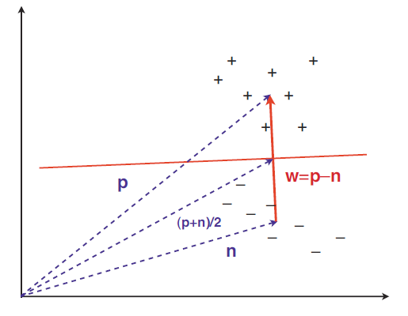
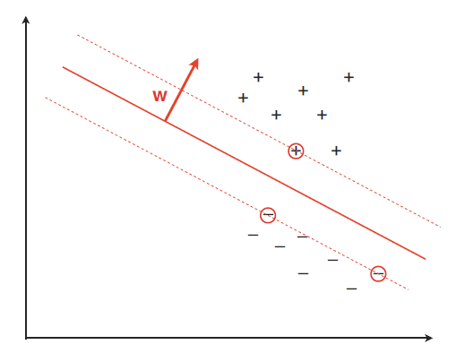
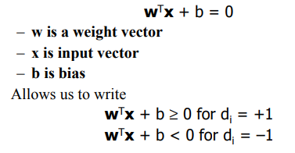
Geometric Models
Basic Linear Classifier
Support Vector Machine
w·x =t, with w= p−n; the decision threshold can be found by (p+n)/2
P= Center of mass of +
N= Center of mass of -

Slide 21
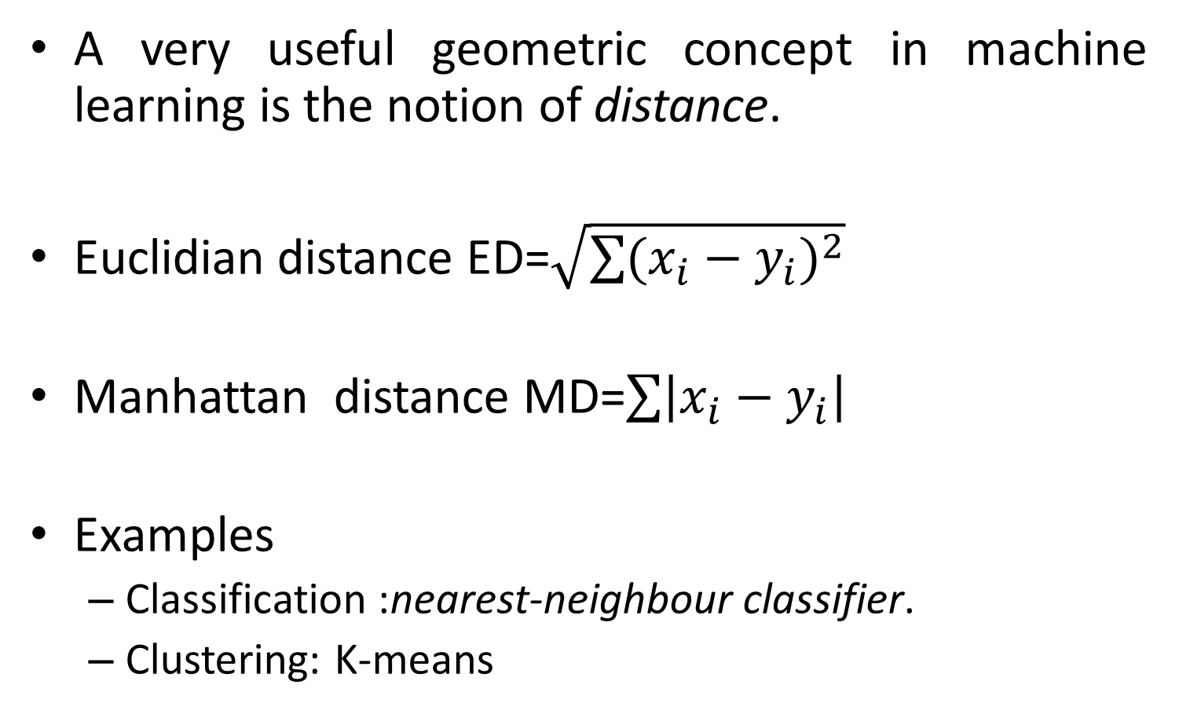
Geometric Model

Slide 22
Probabilistic Models
Let X denote the variables we know about, (feature values) and let Y denote the target variables we’re interested in, (the instance’s class).
The key question in machine learning is how to model the relationship between X and Y i.e., conditional probability P(Y |X).
This is called a posterior probability because it is used after the features X
There exists another conditional probability, called as likelihood function P(X|Y ) are observed.

Slide 23
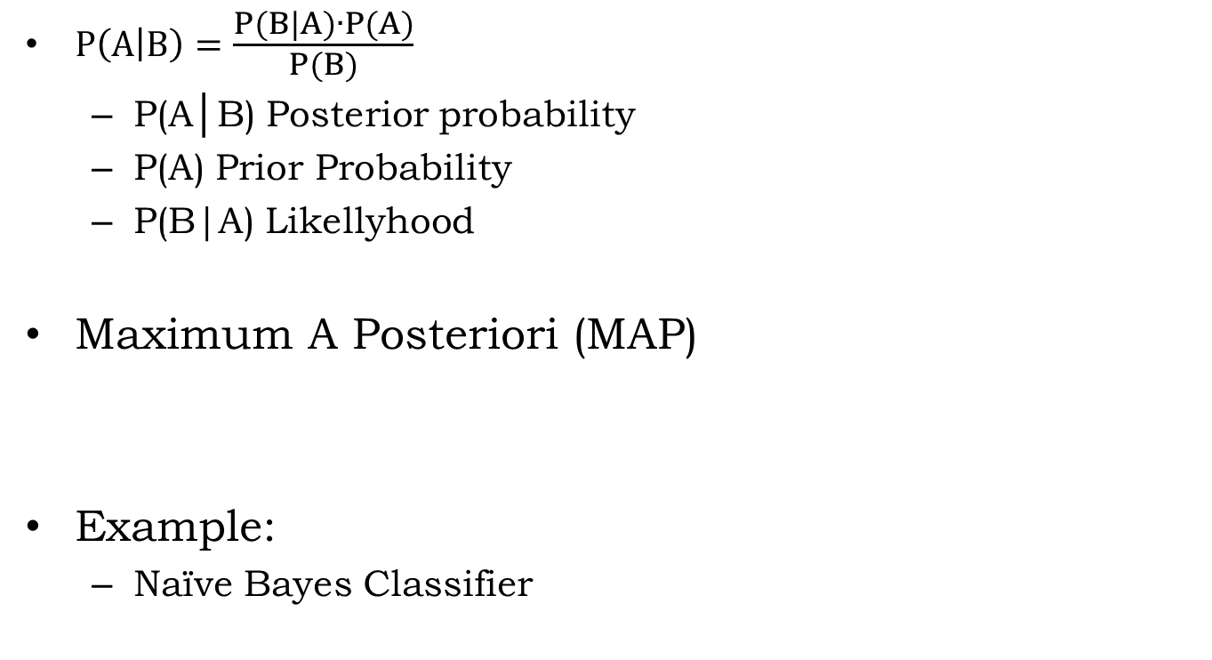

Probabilistic Models: Bayes Theorem

Slide 24
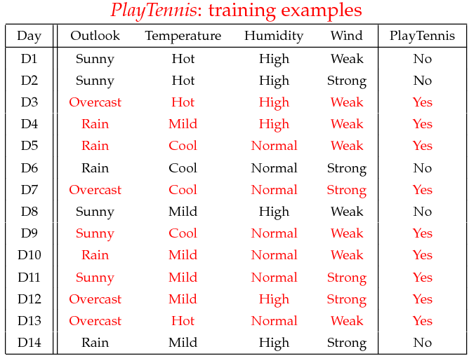
Example for Probabilistic Model
D15 Sunny Cool High Strong ?

Slide 25
Wind=14
Total=14
Weak=8
Strong=6
Yes=9
No=5
Yes=6
Yes=3
No=2
No=3
P(Yes)=9/14
P(No)=5/14
P(Weak/Yes)=6/9
P(Strong/Yes)=3/9
P(Weak/No)=2/5
P(Strong/No)=3/5
Humidity=14
High=7
Normal=7
Yes=3
Yes=6
No=4
No=1
P(High/Yes)=3/9
P(Normal/Yes)=6/9
P(High/No)=4/5
P(Normal/No)=1/5

Slide 26
Temperature
P(Hot/Yes)=2/9
P(Hot/No)=2/5
P(Mild/Yes)=4/5
P(Mild/No)=2/5
P(Cool/Yes)=3/9
P(Cool/No)=1/5
Hot=4
Mild=6
Cool=4
Yes=2
No=2
Yes=4
No=2
Yes=3
No=1
Outlook
P(Sunny/Yes)=1/9
P(Sunny/No)=4/5
P(Overcast/Yes)=4/9
P(Overcast/No)=0/5
P(Rain/Yes)=3/9
P(Rain/No)=2/5
Sunny=5
Overcast=4
Rain=5
Yes=1
No=4
Yes=4
No=0
Yes=3
No=2

Slide 27
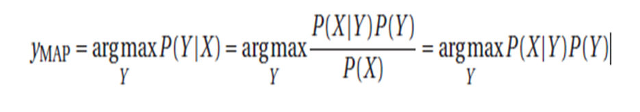
Naïve bayes
Example for Probabilistic Model
X={sunny, cool, high, strong}
P(X/Yes)=
P(Yes)*P(Sunny/Yes) )*P(Cool/Yes) *P(high/Yes) *P(strong/Yes)
=0.0053
P(X/No)=
P(No)*P(Sunny/No)*P(Cool/No) *P(high/No) *P(strong/No)
=0.206
Maximum A Posteriori (MAP):
According to Majority class Rule: Max(0.0053,0.206)=0.206
The Answer is NO

Slide 28
Logical Models
The third type of model are more algorithmic in nature.
They are called ‘logical’ because models of this type can be easily translated into rules that are understandable by humans, such as “If condition then class = C1.”
Such rules are easily organized from a tree structure, which is called as feature tree.

Slide 29
Logical Models
Feature Tree
Features are used to iteratively partition the instance space.
Leaves denote instance class.
Feature Trees whose leaves are labeled with classes area commonly called as decision trees.
Example:
Decision Tree Induction Algorithm

Slide 30
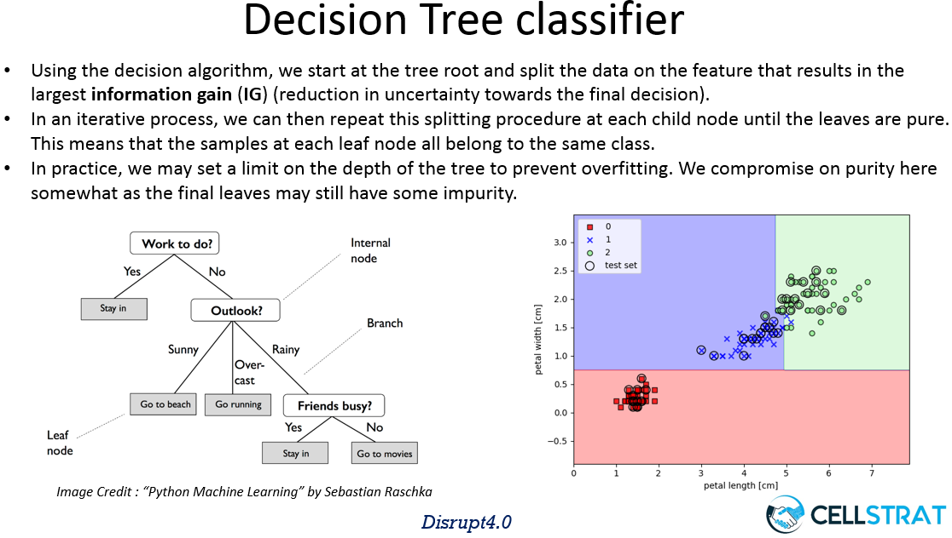
Example for Logical Models
Disjunction(or,V) or Conjunction(and,^) are used to form the rules from the feature tree.

Slide 31
Logical Models
An interesting aspect of logical models, which sets them aside from most geometric and probabilistic models, is that they can, to some extent, provide explanations for their predictions.
For example, a prediction assigned by a decision tree could be explained by reading off the conditions that led to the prediction from root to leaf.
The model itself can also easily be inspected by humans, which is why they are sometimes called declarative.

Slide 32
Another Categorization of Models
Based om the way of handling the instance space.
Groping and Grading Models.
Grouping models do this by breaking up the instance space into groups or segments, the number of which is determined at training time.
Grading models, on the other hand, do not employ such a notion of segment. Rather than applying very simple, local models, they form one global model over the instance space.

Slide 33
Algorithms Vs Models
 | Geometric | Probabilistic | Logical | Grouping | Grading
Decision Trees
Naïve Bayes
SVM
K-means
Associations
ANN

Slide 34

Algorithms Vs Models
 | Geometric | Probabilistic | Logical | Grouping | Grading
Decision Trees |  |  | √
Naïve Bayes
SVM
K-means
Associations
ANN

Slide 35
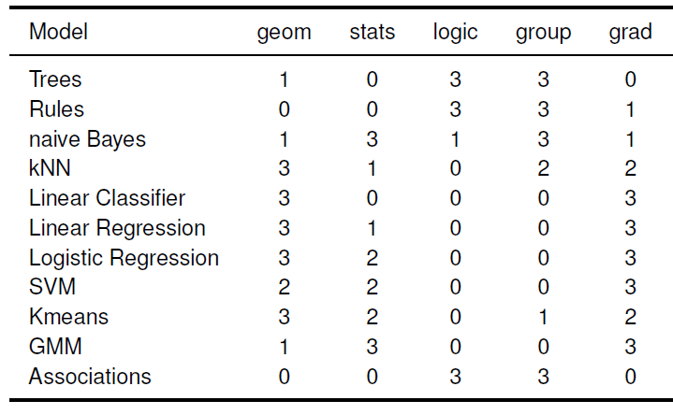
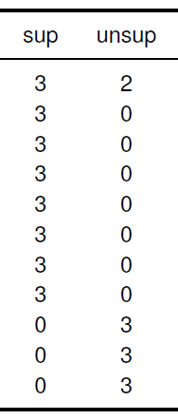
Algorithms Vs Models

Slide 36
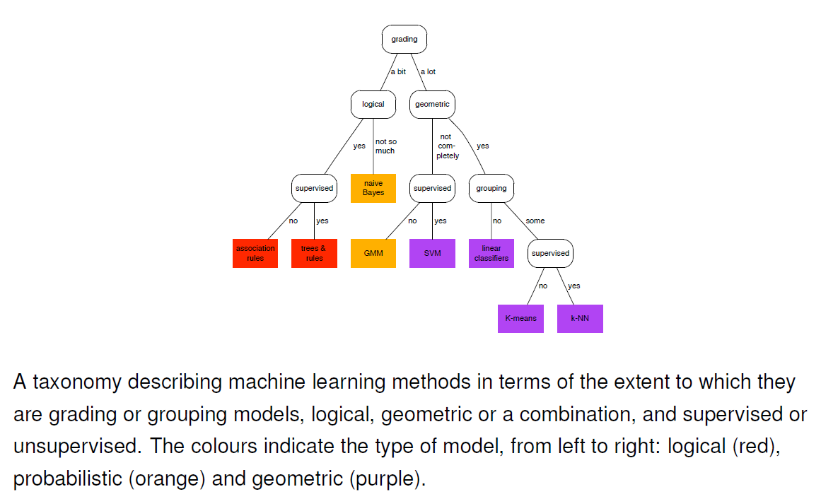
Algorithms Vs Models

Slide 37
Ingredient 3: Features

Slide 38
Features
Features: the workhorses of machine learning
Features determine much of the success of a machine learning application, because a model is only as good as its features.
A feature can be thought of as a kind of measurement that can be easily performed on any instance.
domain of the feature
Univariate Model

Slide 39
Feature
Features-Example
Category | Features
Housing Prices | No. of Rooms, House Area, Air Pollution, Distance from facilities, Economic Index city, Security Ranking etc.
Spam Detection | presence or absence of certain email headers, the email structure, the language, the frequency of specific terms, the grammatical correctness of the text etc.
Speech Recognition | noise ratios, length of sounds, relative power of sounds, filter matches
Cancer Detection | Clump thickness, Uniformity of cell size, Uniformity of cell shape, Marginal adhesion, Single epithelial cell size, Number of bare nuclei, Bland chromatin, Number of normal nuclei, Mitosis etc.
Cyber Attacks | IP address, Timings, Location, Type of communication, traffic details
Video Recommendations | Text matches, Ranking of the video, Interest overlap, history of seen videos, browsing patterns etc.
Image Classification | Pixel values, Curves, Edges etc.

Slide 40
Two uses of Features
Use-1: Feature as a Split.
features are used to zoom in on a particular area of the instance space.
Let f be a feature counting the number of occurrences of the word ‘xxxx’ in an e-mail, and let x stand for an arbitrary e-mail
Condition f (x) = 0 selects e-mails that don’t contain the word ‘xxxx’
f (x) !=0 selects e-mails that do
f (x) ≥ 2 selects e-mails that contain the word at least twice.
Such conditions are called binary splits, because they divide the instance space into two groups: those that satisfy the condition, and those that don’t.
Non-binary splits are also possible: for instance, if g is a feature that has the word ‘tweet’
‘Tiny’ for e-mails with up to 20 words
‘short’ for e-mails with 21 to 50 words
‘medium’ for e-mails with 51 to 200 words
‘long’ for e-mails with more than 200 words
Then the expression g (x) represents a four-way split of the instance space.

Slide 41
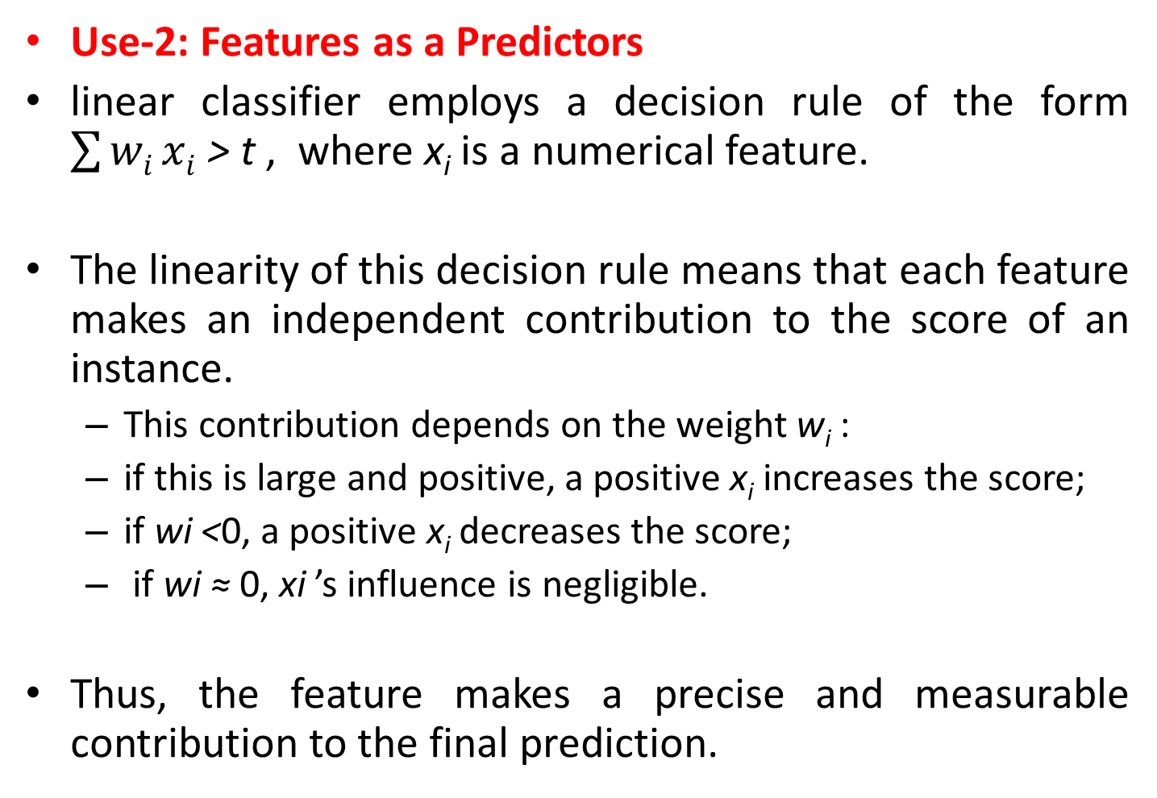
Two uses of Features

Slide 42
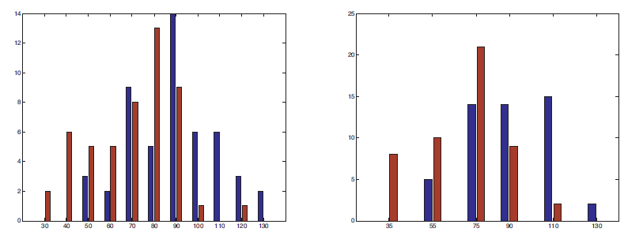
Feature Construction and Transformation
It is often natural to build a model in terms of the given features. However, we are free to change the features, or even to introduce new features.
For instance, real-valued features often contain unnecessary detail that can be removed by discretization.

Slide 43
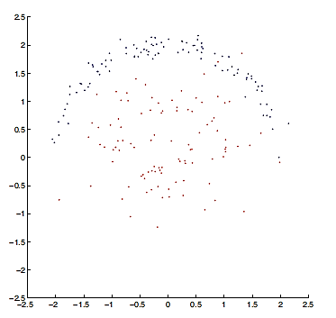
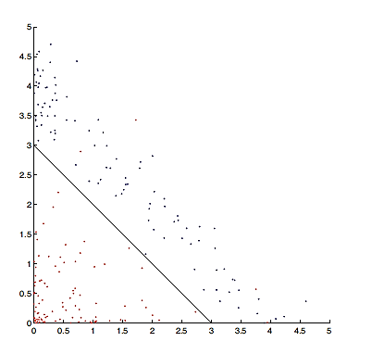
Feature Construction and Transformation
Feature Transformation

Slide 44
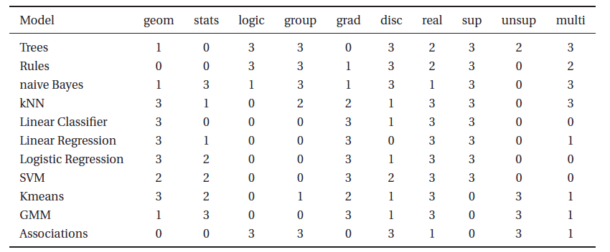
Interaction between Features
Example:
Positively correlated: ‘logic’ and ‘disc’
Negatively correlated: ‘logic’ and ‘grad’.

Slide 45
Summary
A computer program is said to learn from experience E with respect to some class of tasks T and performance measure P, if its performance at tasks in T, as measured by P, improves with experience E.
The three ingredients of Machine Learning are:
Task
Supervised
unsupervised
Model
Predictive Vs Descriptive
Geometric Vs Probabilistic Vs Logical
Grouping Vs Grading
Features
Feature as a split
Feature as a predictor
Feature construction and transformation
Interaction between the features

